Slide 1
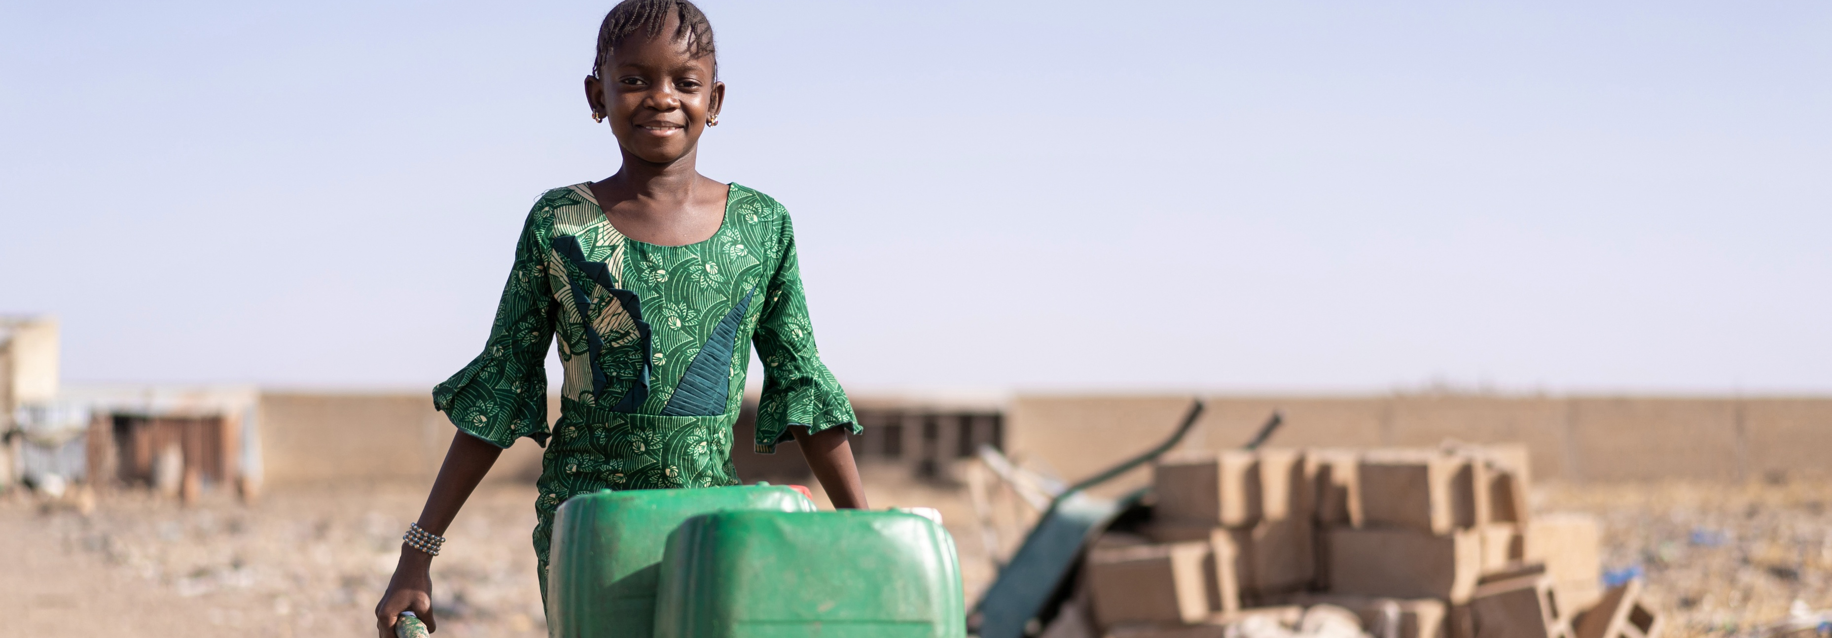



Measuring Progressive Realisation of the Right to Water across South Africa
Launch of the Water Rights Tracker
Prof Tracy-Lynn Field
21 October 2026

Slide 2
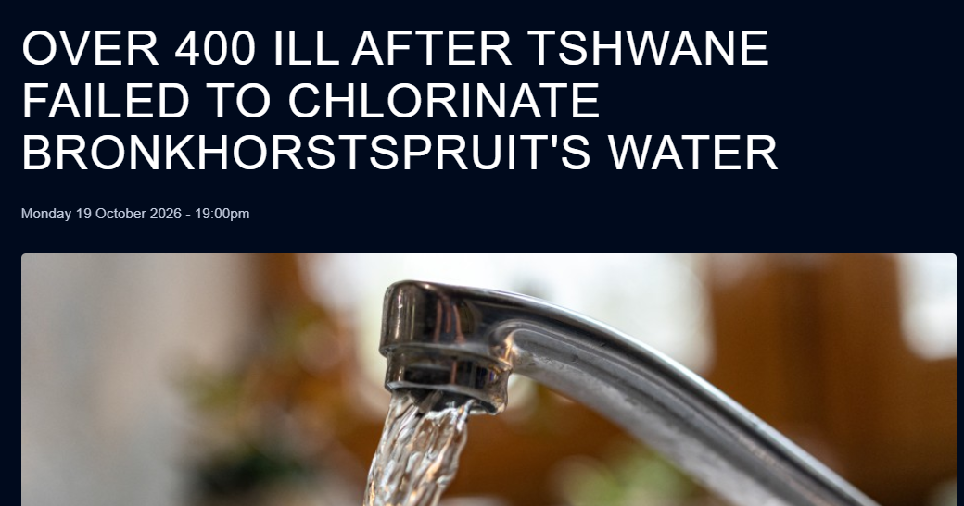

Slide 3
Microbiological compliance, Gauteng WSAs (Source: 2023 Blue Drop Report)

Slide 4
Shortages of process controllers and scientists, Gauteng WSAs (Source: 2023 Blue Drop Watch Report)

Slide 5
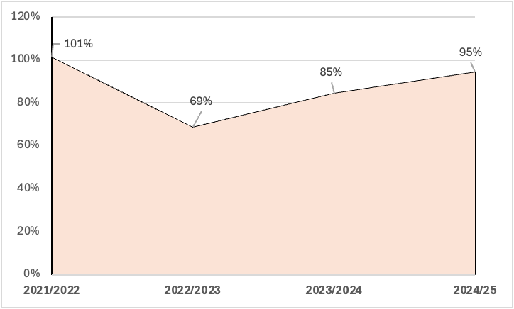
City of Tshwane, Revenue Collection Rate 2021/22-2024/25 (Actual Revenue/Budgeted Revenue) (Source: MFMA Section 71 Schedule C 2021 to 2025 Reports)

Slide 6
Relationship between infrastructure extent and population size, Gauteng Water Services Authorities (Source: 2023 Blue Drop Report).

Slide 7
Water Use Efficiency Scores (litres per person per day), Gauteng WSAs (Source: 2023 Blue Drop Report).

Slide 8
Non-revenue Water, Gauteng WSAs (Source: Auditor-General 2023/24 MFMA Audit).

Slide 9
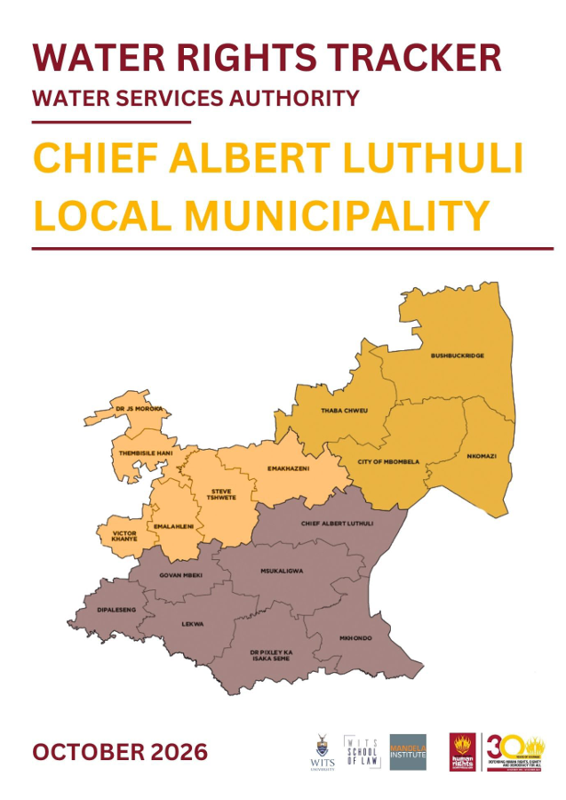
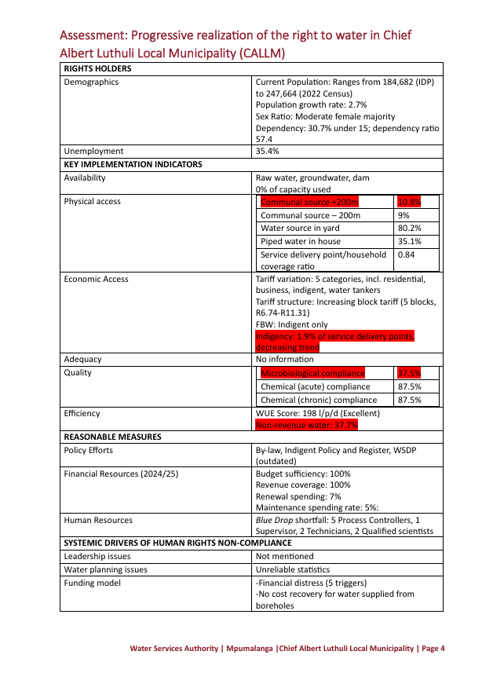
Water Services Authority Profiles
144 Profiles
85 Indicators (more than 12,200 data points)
3,500 pages
Synthesis of multiple public datasets and in-person engagements with 170+ municipal officials
Data across five thematic areas:
Context (Demographics, Financial Capacity, Water Management, Political Stability)
Policy Efforts (Water By-Law Water Services Development Plan, General Poolicy)
Resource Efforts (Financial, Infrastructure, Human Resources)
Implementation (Physical, Economic, Adequacy, Quality, Efficiency)
Oversight (Courts, SAHRC, Public Protector, Auditor-General, Parliamentary and Legislative Oversight)
ALL AVAILABLE AT https://www.wits.ac.za/mandelainstitute/research/projects/water-rights-tracker-report/

Slide 10
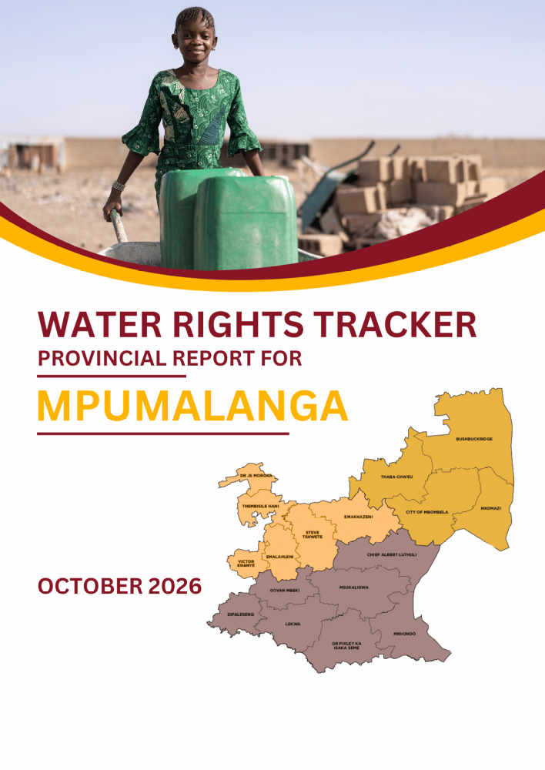
WRT Provincial Reports
Part A: Critical contextual information on the right of access to sufficient water and the systemic drivers of water services dysfunction
Part B: Province-specific assessment of progressive realisation of the right of access to sufficient water

Slide 11
Red Flag Indicators for Human Rights Compliance – Outcomes
WSA | >200m Physical Access >7% | FBW <22% of population | Microbio-logical Non-Compliance | Chemical (Acute) Compliance | WUE Score >250 l/p/d | NRW >30%
Alfred Nzo DM | No | Yes | Yes | Yes | No | No
Amathole DM | Yes | Yes | Yes | Yes | No | No
Blue Crane Route LM | No | Yes | Yes | Yes | No | No
Buffalo City Metro | No | No | Yes | No | No | Yes
Chris Hani DM | Yes | Yes | Yes | Yes | No | No
Dr Beyers Naude LM | No | No | Yes | Yes | No | Yes
Joe Gqabi DM | No | Yes | Yes | No | No | Yes
Kouga LM | No | No | No | Yes | Yes | Yes
Koukamma LM | No | No | Yes | Yes | No | No
Makana LM | No | Yes | Yes | Yes | No | No info
Ndlambe LM | Yes | Yes | Yes | No | No | Yes
Nelson Mandela Metro | No | Yes | Yes | No | Yes | Yes
OR Tambo DM | Yes | Yes | Yes | Yes | No | No
Sundays River Valley LM | No | No | Yes | Yes | No | Yes
WSA | >200m Physical Access >7% | FBW <22% of population | Microbio-logical Non-Compliance | Chemical (Acute) Compliance | WUE Score >250 l/p/d | NRW >30%
Ekurhuleni Metro | No | Yes | No | No | Yes | No
Emfuleni LM | No | No | No | Yes | Yes | Yes
Johannesburg Metro | No | No | No | No | Yes | Yes
Lesedi LM | No | Yes | No | No | No | Yes
Merafong LM | Yes | Yes | No | No | Yes | Yes
Midvaal LM | Yes | Yes | Yes | No | Yes | Yes
Mogale City LM | No | Yes | No | No | Yes | No
Rand West LM | Yes | Yes | No | No | N o | Yes
Tshwane Metro | No | Yes | Yes | No | Yes | Yes
Gauteng
Eastern Cape

Slide 12
Red Flag Indicators for Human Rights Compliance – Enablers
WSA | Political Disruption | Outdated or No WSDP | Revenue Collection Rate <90% | WTW Capacity >90% | Mainten-ance Spending <8% | Technical/ WTW Ratio <1:1
Alfred Nzo DM | No | No | Yes | No | No | Yes
Amathole DM | Yes | No | No | No | Yes | Yes
Blue Crane Route LM | No | No | Yes | Yes | Yes | Yes
Buffalo City Metro | No | No | No | Yes | Yes | No
Chris Hani DM | No | No | Yes | No | Yes | Yes
Dr Beyers Naude LM | No | No | Yes | No | No | Yes
Joe Gqabi DM | No | No | No | No | Yes | Yes
Kouga LM | No | No | Yes | No | No | No
Koukamma LM | No | No | Yes | Yes | Yes | Yes
Makana LM | Yes | Yes | No | No | Yes | No
Ndlambe LM | No | Yes | Yes | No | Yes | Yes
Nelson Mandela Metro | Yes | No | No | No | Yes | No
OR Tambo DM | Yes | Yes | Yes | No | Yes | Yes
Sundays River Valley LM | No | Yes | Yes | Yes | Yes | Yes
WSA | Political Disruption | Outdated or No WSDP | Revenue Collection Rate <90% | WTW Capacity >90% | Mainten-ance Spending <8% | Technical/WTW Ratio <1:1
Ekurhuleni Metro | Yes | No | Yes | n/a | Yes | No
Emfuleni LM | Yes | No | No | No | Yes | No
Johannesburg Metro | Yes | Yes | No | n/a | Yes | No
Lesedi LM | Yes | No | No | n/a | Yes | No
Merafong LM | Yes | No | Yes | n/a | Yes | Yes
Midvaal LM | No | No | No | No | No | No
Mogale City LM | Yes | Yes | No | n/a | No | No
Rand West LM | Yes | No | No | n/a | Yes | Yes
Tshwane Metro | Yes | No | No | No | Yes | Yes
Gauteng
Eastern Cape

Slide 13
Cross-Cutting Recommendations – A Sample
Protect the operational independence and stability of municipal water services.
Establish a coordinated population and household data protocol for water services planning involving Statistics South Africa, DWS, municipalities and National Treasury.
Review the long-term sustainability of the municipal water services funding model.
Free Basic Water: Simplify, standardise and digitise indigent registration processes while improving proactive identification of qualifying households.

Slide 14
Three Take-Home Messages
Everyone in South Africa has a right to sufficient water – from Kamiesberg to Ngaka Modiri Molema to CoCT and CoJ.
We need to understand, debate and resolve the systemic drivers of water services dysfunction.
We need a whole-of-government and whole-of-society approach.

Slide 15

Thank you
Please send comments/feedback to Tracy-Lynn.Field@wits.ac.za

